Slide 1
Utilization of Emergency Management Research Literature
Deborah J. Persell, PhD, RN, APN
3rd Emergency Management Theory and Research Workshop

Slide 2
Background:
Description of the Problem
Urgent need for research literature
Multiple web-based platforms
Utilization of library resources declining
Lack of credibility awareness

Slide 3
Review of Literature
Traditional use of libraries doesn’t meet student needs (Gardner & Eng, 2005; May & Swabey, 2015)
Technology has changed how students access literature (Cha & Kim, 2015; Gardner & Eng, 2005; Gayton, 2008; May & Swabey, 2015; Saunders, 2015; Simmonds & Andaleeb, 2001)
Students value communal aspects of libraries (Gayton, 2008)
Familiarity with library and its resources increases student use (Soria, Fansen & Nackerud, 2013)

Slide 4
Assessment of Student Utilization of Library Use
15 Librarians, 18 support staff
  1 librarian assigned to DPEM
Purchased $66,000 in EM literature
  Journal use unable to track
  Book use not tracked by student major
    82 checked out at least once
    23 checked out more than twice
    2 checked out more than 9 times

Slide 5
Web-based utilization
Internet sites versus Databases
  Some credible
  Few research based
  Most biased
Health Alert Networks
News stories – credible or not
Reliance on personal experience
Wikipedia

Slide 6
Course Requirements/Resources
Rubric driven assignments
  Peer reviewed research articles required
  Application/critique of articles required
Resident Librarian in course
Faculty

Slide 7
Gap in Information Access
Interventions and programs are necessary to bridge this gap and facilitate the dissemination of evidence-based information to elevate the quality of work and ultimately the discourse in the discipline.

Slide 8
Purpose
Improve utilization of evidence-based literature in disaster preparedness and emergency management.

Slide 9
Aims
Increase awareness, access, and utilization of evidence and web based databases.
Develop tools and resources to facilitate awareness, access and utilization of scientific databases and journals.
Increased knowledge regarding disaster preparedness and management.

Slide 10
Methods
Soft systems framework
Quasi-experimental design
IRB approval
Pre/Post Survey
Convenience Sample
  Students
  Professionals

Slide 11
Soft Systems Methods
Framework to understand the different perspectives of different stakeholders related to the problem under investigation.
Facilitates the creation of solutions that action-based methods utilize to tackle real-world problems.
Seven step process.
(Por, 2008)

Slide 12
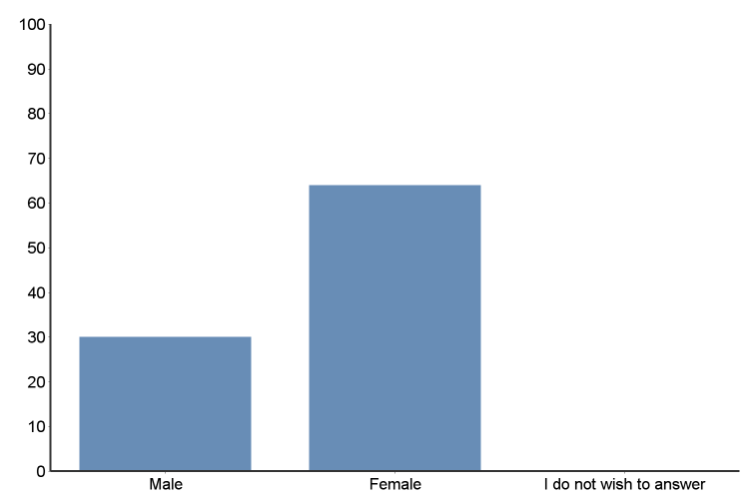
What is your gender?

Slide 13
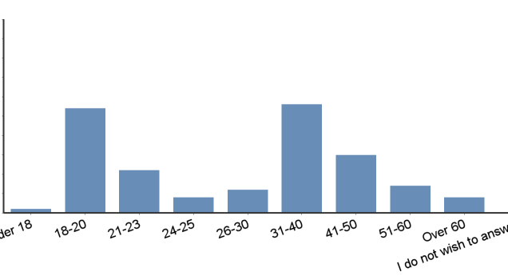
What is you’re age?

Slide 14
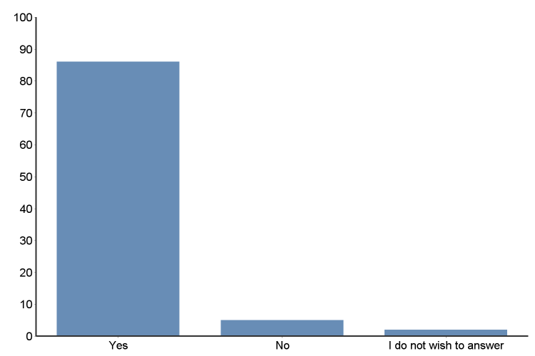
Is it assumed that you will read research literature as part of your education or employment?

Slide 15
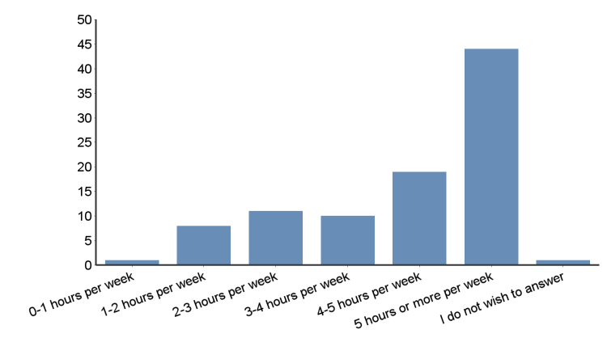
How many hours a week do you study?

Slide 16
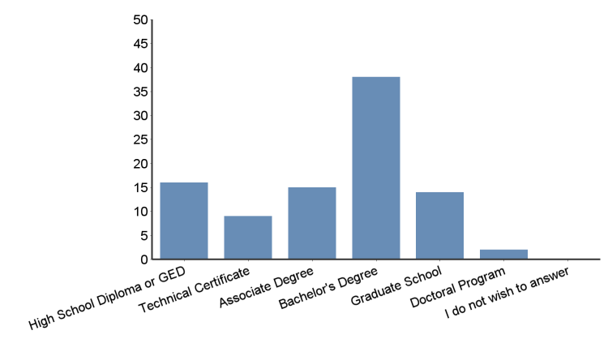
Select the highest level of education you have completed or are currently enrolled in.

Slide 17
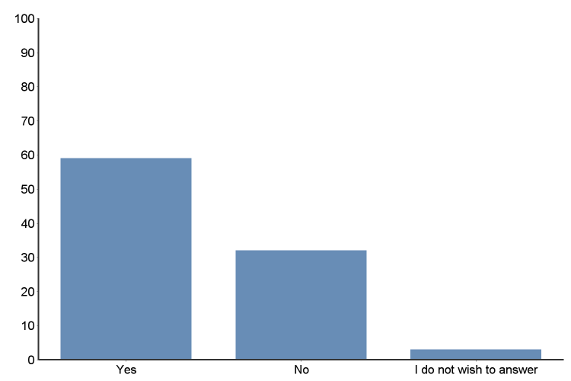
Are you allowed time in-class or on the job for reading research literature?

Slide 18
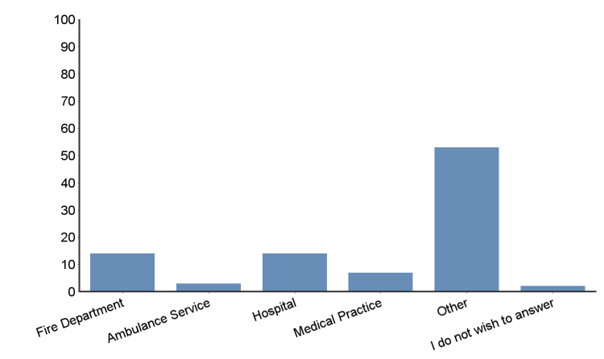
Which of the following best represents the agency you are associated with?

Slide 19
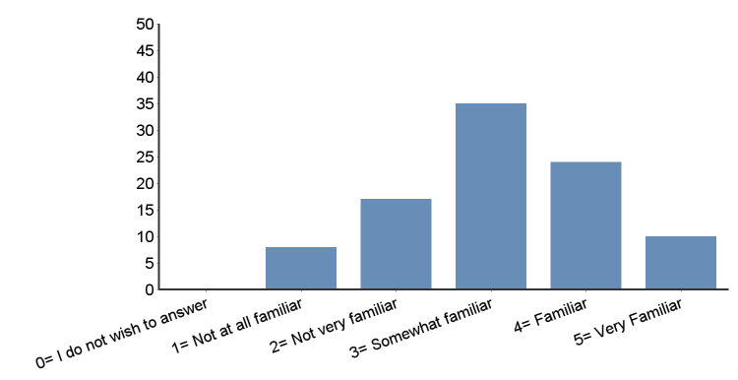
Please rate your familiarity with the terms listed below:

Slide 20
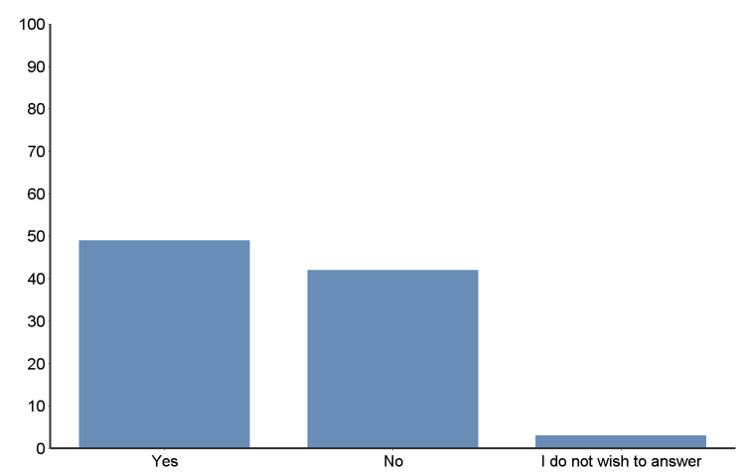
Do you regularly scan the tables of contents or abstracts of research articles?
Notes:
Journal of Homeland Security and Emergency Management
International Journal of Mass Emergencies and Disasters
Public Administration Review
Crisis Response Journal
Journal of Public Administration Research Theory

Slide 21
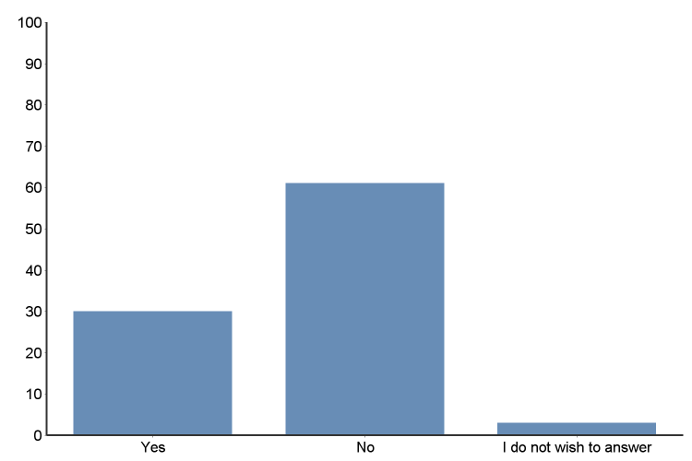
Do you regularly read the full content of research-based articles?

Slide 22
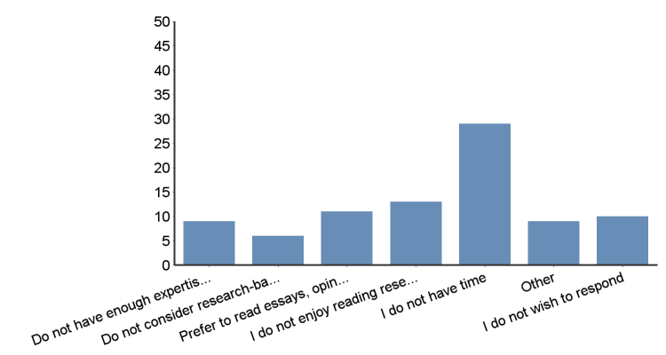
If you do not regularly read research-based articles please tell us the reasons

Slide 23
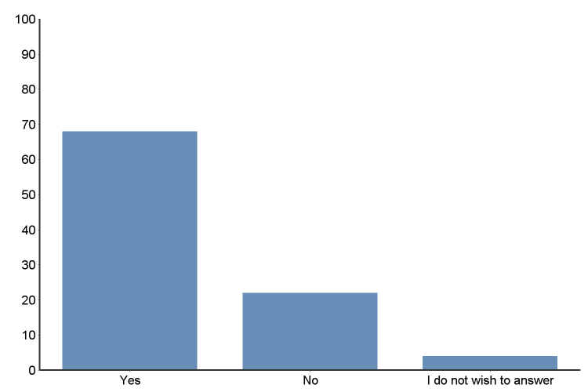
Do you believe your past education has adequately prepared you to read and understand research-based literature?

Slide 24
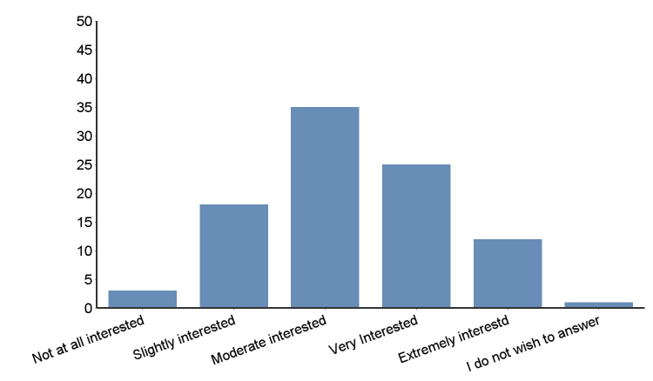
If information was provided to help identify and examine research articles and scientific databases would you be interested?

Slide 25
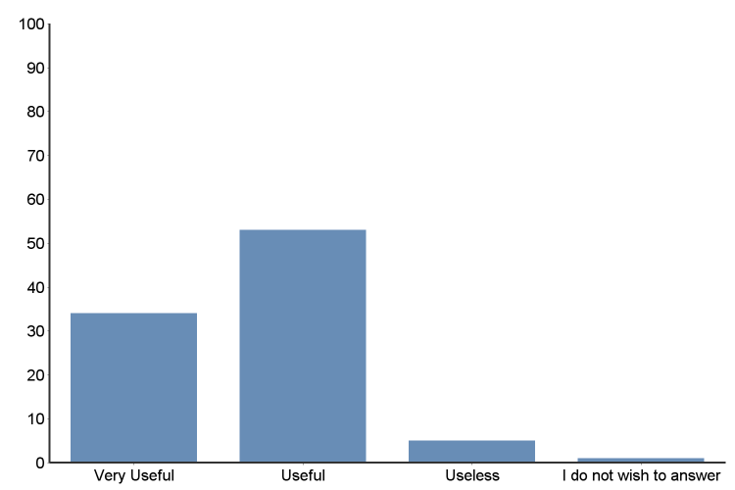
How useful do you think information about using scientific databases and journals are for your education program or job?

Slide 26
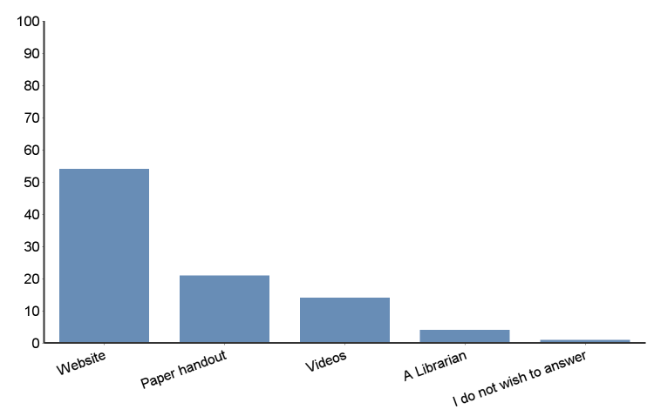
If such information were made available to you, which format would you most prefer it to be?

Slide 27
Conclusions
Utilization of research is an expectation in education and employment
Time is the most provided reason for not reading research literature (38%).
  63% are given time for this
Only 32% read past the abstract

Slide 28
Conclusions continued
We have not done a good enough job to demonstrate the relevance of research literature
  12% don’t have enough expertise to use research
  8% don’t consider research relevant
  14% prefer opinion based articles
  17% do not enjoy or are not interested in research
Yet, 72% say their education sufficiently prepared them to read and understand research

Slide 29
Conclusions continued
Approximately 25% are familiar or very familiar with search terms
Interest in learning to search for, read and understand research is found
  37% moderately interested
  27% very interested
  13% extremely interested
They do not prefer librarian assistance to learn

Slide 30
Recommendations
Focus groups with students and professionals
Add course content on search words
Include content on identifying credible scholarly literature
Re-evaluate expenditures and types of library assets
Revisit the resident librarian concept to design online communal library atmosphere – include “pushing” literature
Encourage librarian to complete Disaster Information Specialist

Slide 31
Disaster Information Management Research Center
sis.nim.nih.gov/dimrc.html
Disaster Types and Topics
Emergency Response Tools
Disaster Health Literature
Disaster Information Specialist
Librarians & Disasters
NLM Projects & Research
Search TOXINET Databases
Training Courses & Resources

Slide 32
Limitations
Students from one program
Professionals from one current geographic location
Online program prohibits most student’s physical use of library
Determination of utilization of library resources flawed

Slide 33
Selected References
Cha, S. H., & Kim, T. W. (2015). What Matters for Students' Use of
Physical Library Space? The Journal of Academic Librarianship, 41(3), 274-279. doi:10.1016/j.acalib.2015.03.014
Gardner, S., & Eng, S. (2005). What Students Want: Generation Y and the
Changing Function of the Academic Library. Portal: Libraries and the Academy, 5(3), 405-420. doi:10.1353/pla.2005.0034
Gayton, J. T. (2008). Academic Libraries: “Social” or “Communal?” The Nature
and Future of Academic Libraries. The Journal of Academic Librarianship, 34(1), 60-66. doi:10.1016/j.acalib.2007.11.011
May, F., & Swabey, A. (2015). Using and Experiencing the Academic Library: A
Multisite Observational Study of Space and Place. College & Research Libraries, 76(6), 771-795. doi:10.5860/crl.76.6.771

Slide 34
Selected References continued
Por, J. (2008). The use of soft system methodology (SSM) in a serviced
focused study on the personal tutor’s role . Nurse Education in Practice , 335–342 .
Saunders, L. (2015). Academic Libraries' Strategic Plans: Top Trends and
Under-Recognized Areas. The Journal of Academic Librarianship, 41(3), 285-291. doi:10.1016/j.acalib.2015.03.011
Simmonds, P. L., & Andaleeb, S. S. (2001). Usage of academic libraries: The
role of service quality, resources, and user characteristics. Library Trends, 49(4), 626-634. Retrieved November 24, 2015.
Soria, K. M., Fransen, J., & Nackerud, S. (2013). Library Use and Undergraduate
Student Outcomes: New Evidence for Students’ Retention and Academic Success. Portal: Libraries and the Academy Portal, 13(2), 147-164. doi: 10.1353/pla.2013.0010

Slide 35
Contact Information
Deborah J. Persell, PhD, RN, APN
Regional Center for Disaster Preparedness Education
Arkansas State University
P.O. Box 910
State University (Jonesboro), AR 72467
dpersell@astate.edu
870-6880-9296

